Slide 1

MAJOR PROJECT REVIEW - EXTERNAL
Smart Explainable AI Model for Personalized Disease Risk Assessment and Early Disease Prediction
Name : Hemanth Kumar Pattem (Reg. No. 24691F0071)
Project Guide : Dr. SRINIVASAN JAGANNATHAN, M.C.A., Ph.D.,

Slide 2

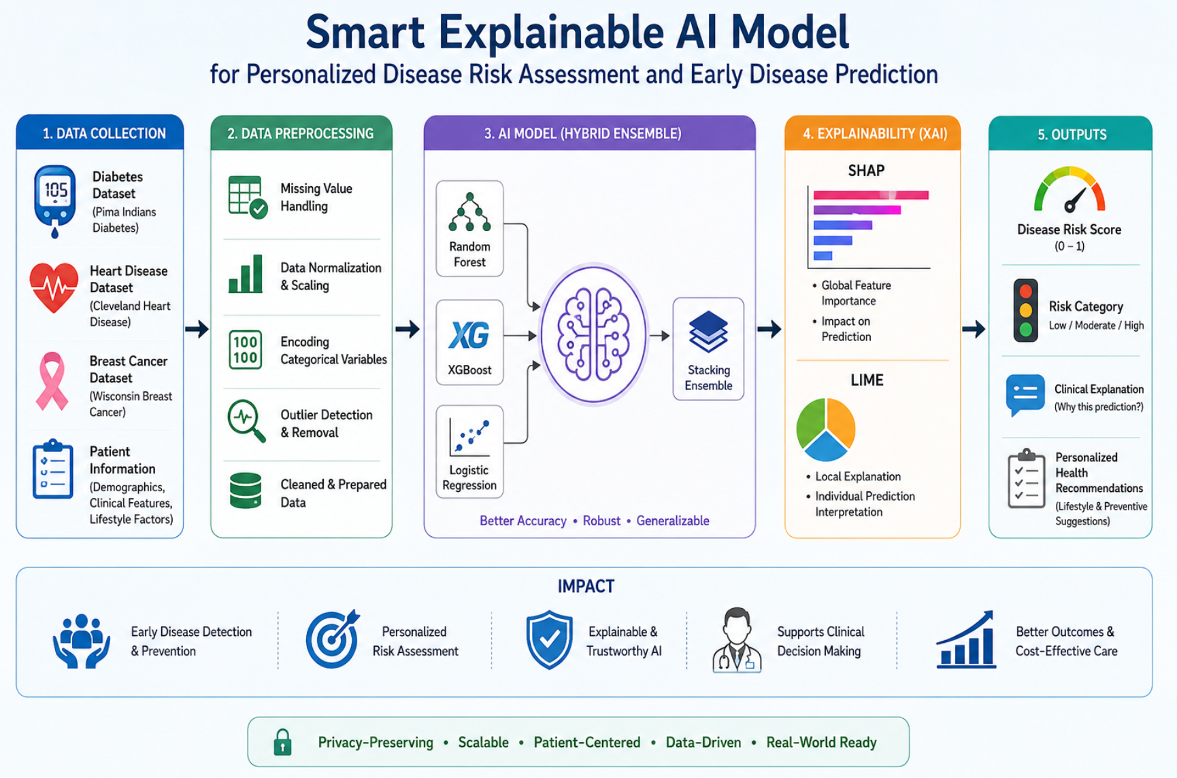
Table of Contents
Abstract
Introduction
Problem Statement
Objectives
Literature Review
Proposed System
Methodology
Overall Architecture diag.
Modules
Implementation
Experimental Results
Conclusion
Future Scope
References

Slide 3
Abstract
Artificial Intelligence (AI) in healthcare enables personalized risk assessment and early disease prediction. However, many existing systems focus on a single disease and lack explainability. This study proposes an Adaptive Explainable AI Framework for predicting diabetes, heart disease, and breast cancer using structured Electronic Health Records (EHR) and benchmark datasets such as Pima Indians Diabetes, Cleveland Heart Disease, and Wisconsin Breast Cancer datasets. A hybrid stacking ensemble combining Random Forest, XGBoost, and Logistic Regression with a Logistic Regression meta-learner is used to improve prediction accuracy, robustness, and generalization. To ensure transparency and trust, Explainable AI (XAI) techniques including SHAP and LIME are integrated for global and local interpretability. The framework identifies key risk factors such as glucose, BMI, and age for diabetes, and area_worst, concave points_worst, and concave points_mean for breast cancer, enabling reliable and interpretable healthcare predictions.

Slide 4
Introduction
AI supports
Traditional systems
Early disease prediction
Personalized treatment
Clinical decision support
Are reactive
Lack personalization
Have limited explainability
Explainable AI (XAI) improves
Proposed framework combines
Transparency
Trust
Clinical adoption
Multi-disease prediction
Explainable AI
Personalized recommendations

Slide 5
Problem Statement
Existing Challenges
Most healthcare AI systems predict only one disease at a time.
Existing systems mainly depend on structured clinical data only.
Many models operate as “Black Box” systems.
Lack of:
Transparency
Interpretability
Personalized recommendations
Multi-disease integration
Difficult to apply in real-world clinical environments.

Slide 6
Problem Statement
Research Gap
There is a need for a:
Unified multi-disease prediction system
Explainable and trustworthy AI framework
Personalized healthcare recommendation system
Clinically applicable intelligent healthcare solution

Slide 7
Objectives
Develop a unified multi-disease prediction system
Use ensemble models for better accuracy
Apply SHAP and LIME for explainability
Identify important clinical risk factors
Provide personalized healthcare recommendations

Slide 8
Literature Review
S.No | Research Paper / Author | Methodology Used | Demerits
1 | G. Mandala et al. – AI and ML in Healthcare: Redefining Diagnostics, Treatment, and Personalized Medicine | Used AI and Machine Learning models for disease diagnosis and personalized healthcare prediction | Limited explainability and mostly theoretical analysis
2 | E. C. Chianumba et al. – Exploring the Role of AI and ML in Improving Healthcare Diagnostics and Personalized Medicine | Applied Machine Learning techniques for healthcare diagnostics and personalized treatment recommendations | Focused mainly on diagnosis, less emphasis on explainability
3 | E. U. Alum and O. P.-C. Ugwu – Artificial Intelligence in Personalized Medicine: Transforming Diagnosis and Treatment | Used AI-driven personalized medicine systems for treatment optimization | Lack of multi-disease prediction framework
S.No | Research Paper / Author | Methodology Used | Merits | Demerits
1 | G. Mandala et al. – AI and ML in Healthcare: Redefining Diagnostics, Treatment, and Personalized Medicine | Used AI and Machine Learning models for disease diagnosis and personalized healthcare prediction | Improved diagnostic accuracy and healthcare automation | Limited explainability and mostly theoretical analysis
2 | E. C. Chianumba et al. – Exploring the Role of AI and ML in Improving Healthcare Diagnostics and Personalized Medicine | Applied Machine Learning techniques for healthcare diagnostics and personalized treatment recommendations | Enhanced clinical decision support and prediction efficiency | Focused mainly on diagnosis, less emphasis on explainability
3 | E. U. Alum and O. P.-C. Ugwu – Artificial Intelligence in Personalized Medicine: Transforming Diagnosis and Treatment | Used AI-driven personalized medicine systems for treatment optimization | Improved patient-specific healthcare recommendations | Lack of multi-disease prediction framework

Slide 9
Proposed System
Adaptive Explainable AI Framework
Multi-disease prediction using ensemble learning
Predicts:
Diabetes
Heart Disease
Breast Cancer
Uses SHAP and LIME for explainability
Provides:
Risk score
Risk category
Clinical explanation
Personalized recommendations

Slide 10
Methodology
Collect datasets for Diabetes, Heart Disease, and Breast Cancer
Preprocess data by handling missing values and normalization
Perform feature engineering and feature selection
Build models using Random Forest, XGBoost, and Logistic Regression
Use Stacking Ensemble for better prediction accuracy
Apply SHAP and LIME for Explainable AI
Generate personalized healthcare recommendations

Slide 11
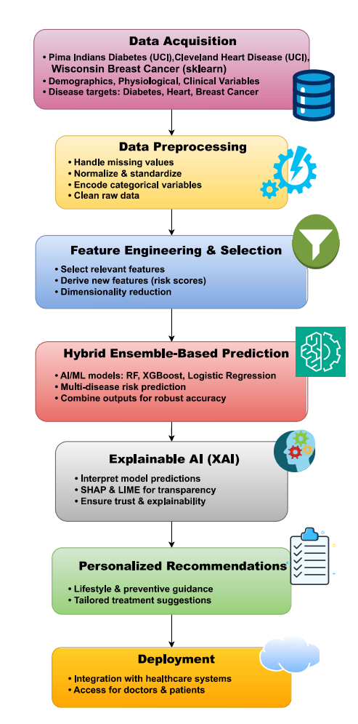
Overall Architecture Diagram

Slide 12
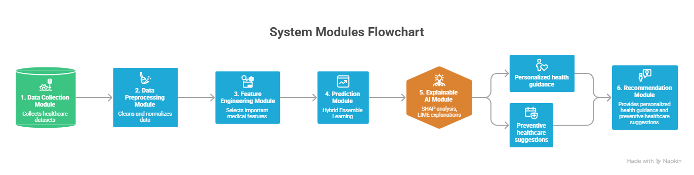
Modules

Slide 13
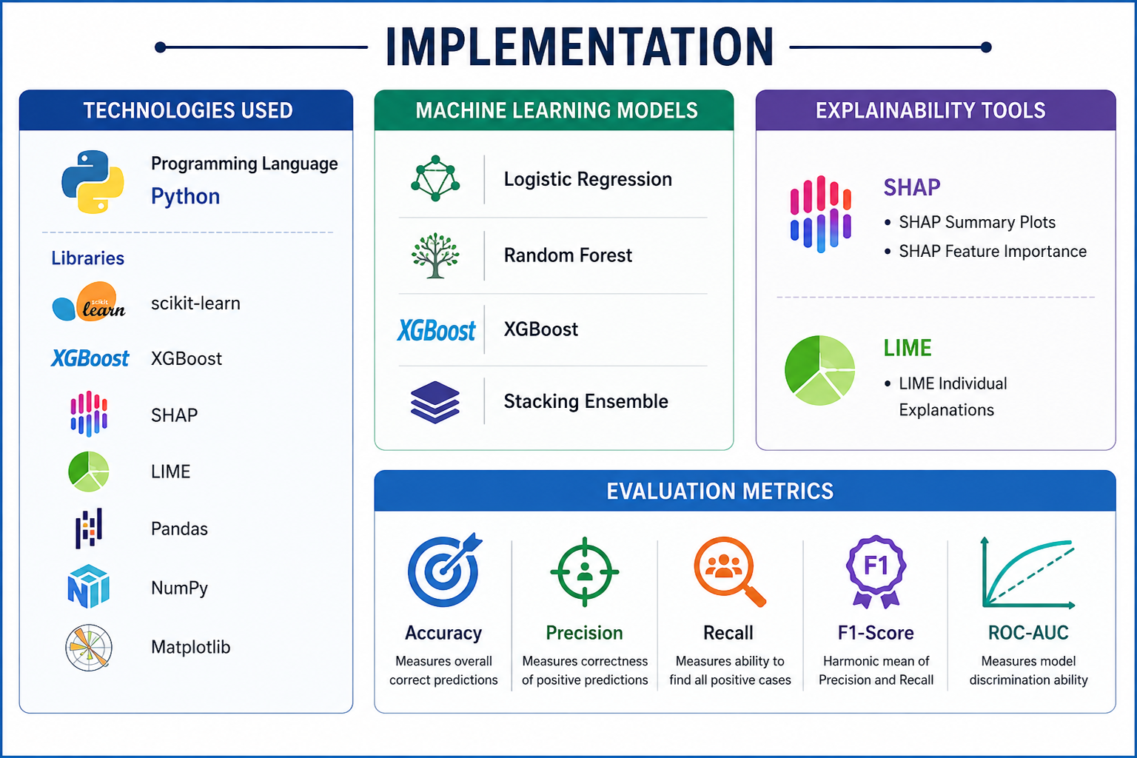
Implementation

Slide 14
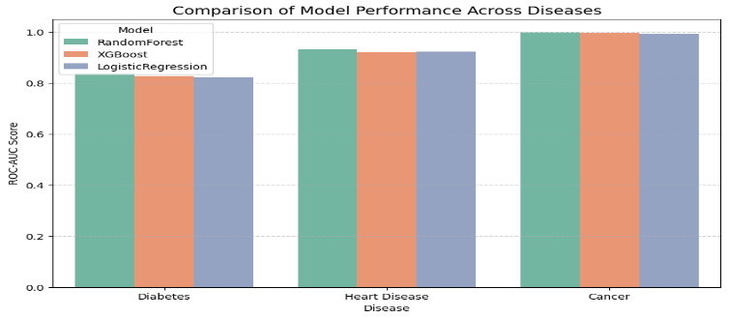
Experimental Results
Individual Models
Disease | Logistic Regression | Random Forest | XGBoost
Diabetes | 0.8226 | 0.8370 | 0.8257
Heart Disease | 0.9213 | 0.9316 | 0.9203
Cancer | 0.9928 | 0.9972 | 0.9951

Slide 15
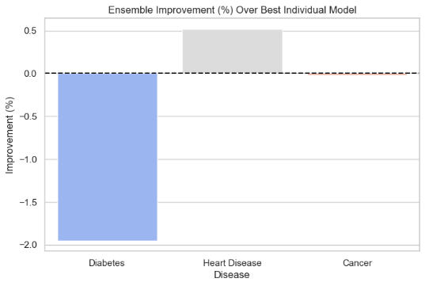
Experimental Results
Comparison Of Best Individual Model Vs. Ensemble Model Performance Across Diseases
Disease | Best Individual AUC | Ensemble AUC | Improvement
Diabetes | 0.8370 | 0.8207 | -1.95%
Heart Disease | 0.9316 | 0.9364 | +0.52%
Breast Cancer | 0.9972 | 0.9971 | -0.02%

Slide 16
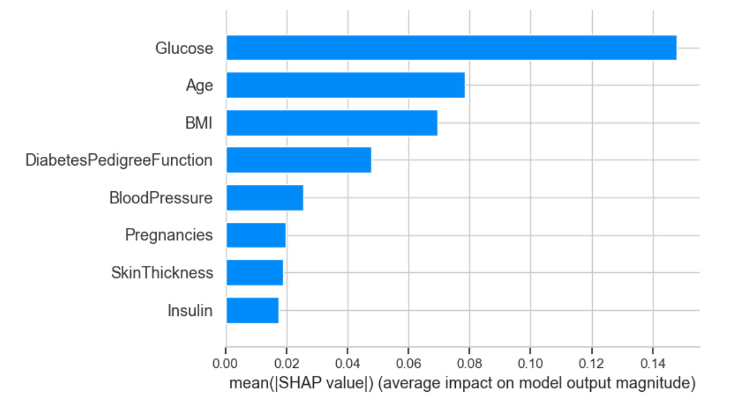
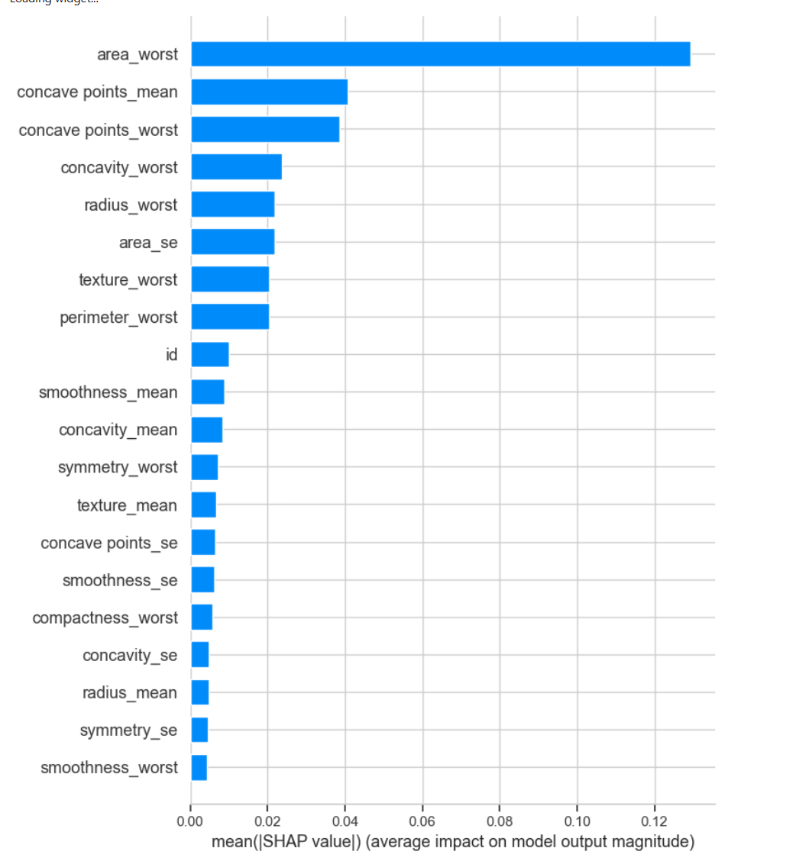
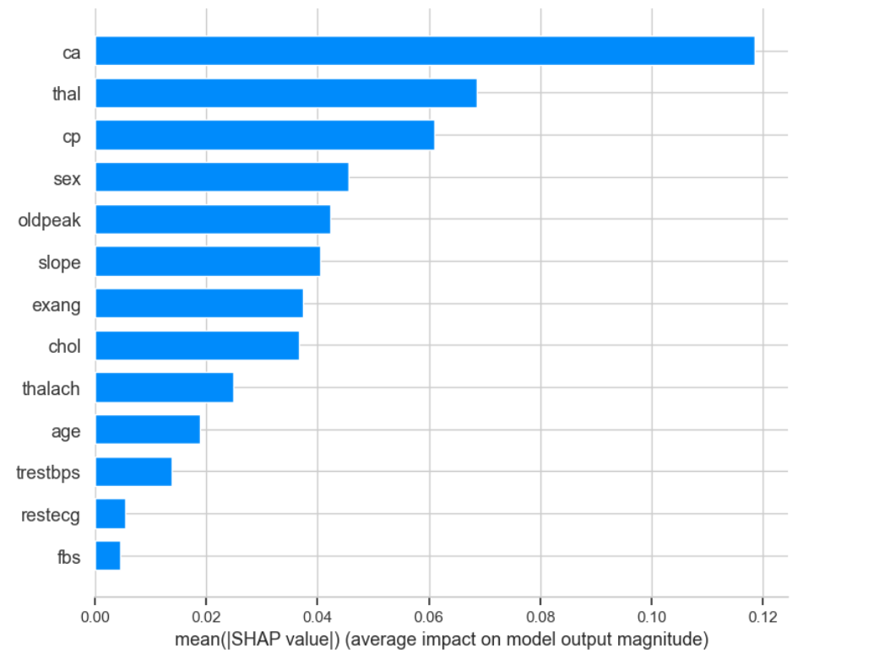
Experimental Results
SHAP Analysis
Diabetes
Cancer
Heart Disease

Slide 17
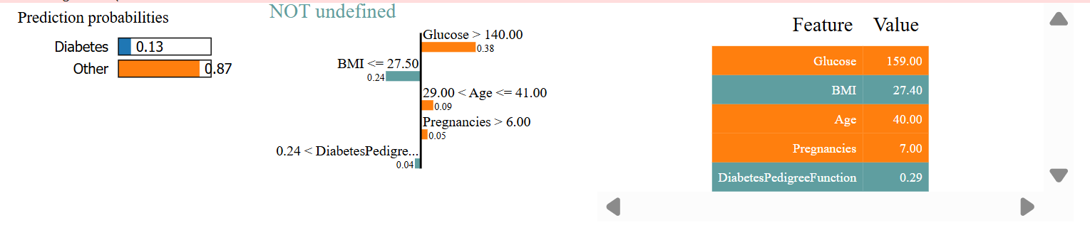
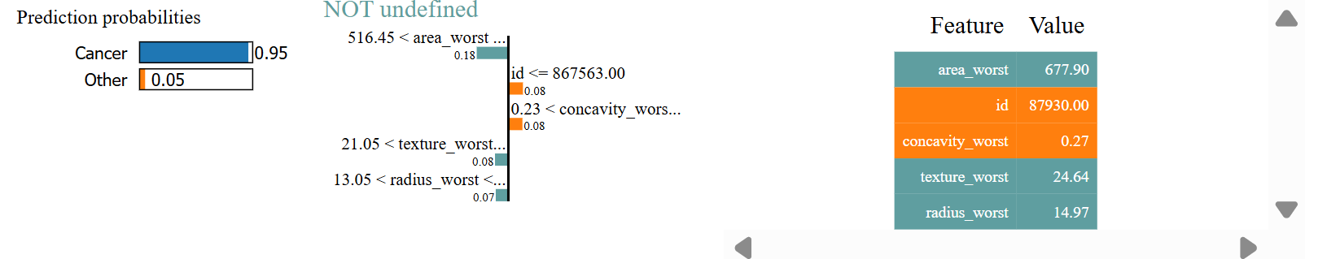
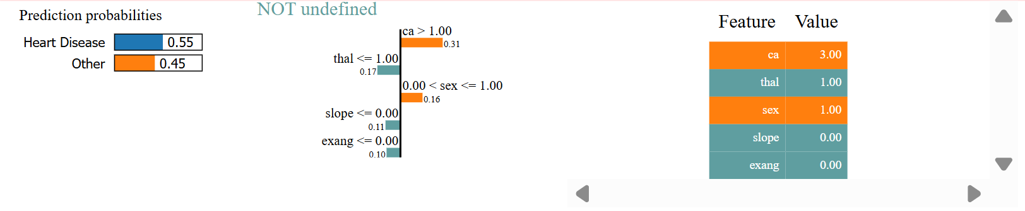
Experimental Results
LIME Analysis
Diabetes
Cancer
Heart Disease

Slide 18
Conclusion
Proposed an Adaptive Explainable AI Framework for multi-disease prediction
Used Random Forest, XGBoost, and Ensemble Learning for high accuracy
Applied SHAP and LIME for model explainability and transparency
Enabled early disease prediction and preventive healthcare
Provided personalized healthcare recommendations
Framework is scalable, reliable, and suitable for real-world healthcare applications

Slide 19
Future Scope
Integrate real-time healthcare and wearable device data
Extend the framework to predict more diseases
Integrate with Clinical Decision Support Systems (CDSS)
Use federated learning for privacy and security
Improve patient engagement and personalized care
Enhance scalability and real-world clinical adoption

Slide 20
References
E. U. Alum and O. P.-C. Ugwu, ‘Artificial intelligence in personalized medicine: transforming diagnosis and treatment’, Discover Applied Sciences, vol. 7, no. 3, p. 193, 2025.
S. Thapa, A. P. Fakiraswamimath, M. Z. Zuluaga D, A. R. Kumar, K. R. Rakesh, and S. Yadav, ‘The Role of Artificial Intelligence in Personalized Medicine: Current Trends and Future Directions’, Frontiers in Health Informatics, vol. 13, no. 3, 2024.
P. Joshi, S. Tiwari, S. Bhatt, and B. Sati, ‘Artificial Intelligence in Healthcare: From Diagnostics to Personalized Medicine And Beyond’, International Journal of Pharmaceutical and Clinical Research, vol. 16, no. 9, pp. 68–72, 2024.
G. Mandala, R. Reddy, A. Nishanth, Z. Yasmeen, and K. K. Maguluri, ‘AI and ML in Healthcare: Redefining Diagnostics, Treatment, and Personalized Medicine’, International Journal of Applied Engineering & Technology, vol. 5, no. S6, 2023.
E. C. Chianumba, N. Ikhalea, A. Y. Mustapha, A. Y. Forkuo, and D. Osamika, ‘Exploring the role of AI and machine learning in improving healthcare diagnostics and personalized medicine’, Journal of Frontiers in Multidisciplinary Research, vol. 4, no. 1, pp. 177–182, 2023.

Slide 21
Thank You

